Slide 1


Slide 2
WEIRD ANALYSERS (GROUP – 6)
A.NAGA PRAVEEN
CH.DURGA
S.KOWSALYA
B.VENU
CH.VIJAYGOPAL
P.RAVI SHANKAR
M.Y.G.VARA PRASAD

Slide 3

Business Objective
The P2P company is interested in quantifying the loan approval and sourcing strategy of loan issuer
It would want to study how the loan application approval rate varies by FICO score, Debt to Income Ratio and Employment length
The distribution of approval rates by the above mentioned three factors can help this company to get a better perspective with regards to its credit disbursement strategy and it can evaluate its issuing decisions later if defaults happen

Slide 4

Understanding:
A peer to peer lending company is interested in understanding the risk profile of its customers and its general loan disbursement strategy.
We have the data and we need to Analyize the Data and find useful insights inorder to prepare a good loan disbursement strategy.
We also need to check the proportionality of FICO score, Debt to Income Ratio and Employment length on the loan acceptance.
We also need to check what are the variables that are useful inorder to approve the customer.

Slide 5

Approach
We had a dataset we first perform Data analysis on the data and eliminate duplicate values and fill the missing values and check the datatypes and convert them as our desired datatype.
Then we Perform some Exploratory Data Analysis on the data to check the relation between the variables and also check how the numeric variables are dispersed we use Data visualizations to present them
Then we follow profiling Approach to present the recommandations
Profiling Approach:
To find the loan strategy from the given data we need to know what kind of people are getting loan and what kind of people are not getting the loan such that we will get the strategy.

Slide 6
 | COUNT | mean | Std | min | Pc 25% | Pc 50% | Pc 75% | max | unique | top | frequency | Variable data type
Loan_amnt | 290336.0 | 13414.15 | 9958.83 | 500.0 | 5375.00 | 10000.0 | 20000.00 | 1400000.0 | -- | -- | -- | Numeric
FICO | 290336.0 | 661.01 | 91.08 | 0.0 | 639.00 | 677.0 | 707.00 | 850.0 | -- | -- | -- | Numeric
Dti | 290336.0 | 260.20 |  |  |  |  |  |  | -- | -- | -- | Numeric
New_Emp_length | 290336.0 | 3.42 | 3.88 | 0.5 | 0.50 | 1.0 | 6.00 | 11.0 | -- | -- | -- | Numeric
Loan_status | 308638 | -- | -- | -- | -- | -- | -- | -- | 15 | Not available | 180611 | object
Addr_state | 308638 |  |  |  |  |  |  |  | 51 | No information | 180611
Accept_d | 308638 | -- | -- | -- | -- | -- | -- | -- | 2120 | No information | 180611 | Object
Issue_d | 308638 | -- | -- | -- | -- | -- | -- | -- | 1478 | No information | 180611 | Object
Funded_amnt | 290336.0 | 5602.20 | 8333.21 | 0.0 | 0.00 | 0.0 | 10000.00 | 35000.0 | -- | -- | -- | Numeric
Accepted |  | -- | -- | -- | -- | -- | -- | -- | 2 | No information | 180611 | object
greaterThan | 308638 | -- | -- | -- | -- | -- | -- | -- | 2 | !>120 | 303678 | object
Between31_120 | 308638 | -- | -- | -- | -- | -- | -- | -- | 2 | !31-120 | 307117 | object

Slide 7
Findings from the Data:
Numeric Data
There are ¼ th people who are applying for loan less than 5000.
The average years of experience of people id 3.31 years.
There are 1 percent of people who are applying loan greater than 35000.
On an average we have a FICO score of 640.05.
Object Data
There are more people who haven’t taken more than 120 days to pay the loan.
loan_status, addr_state, accept_d, issue_d are mostly having no information as values.
There are 51 unique address states in the dataset.

Slide 8
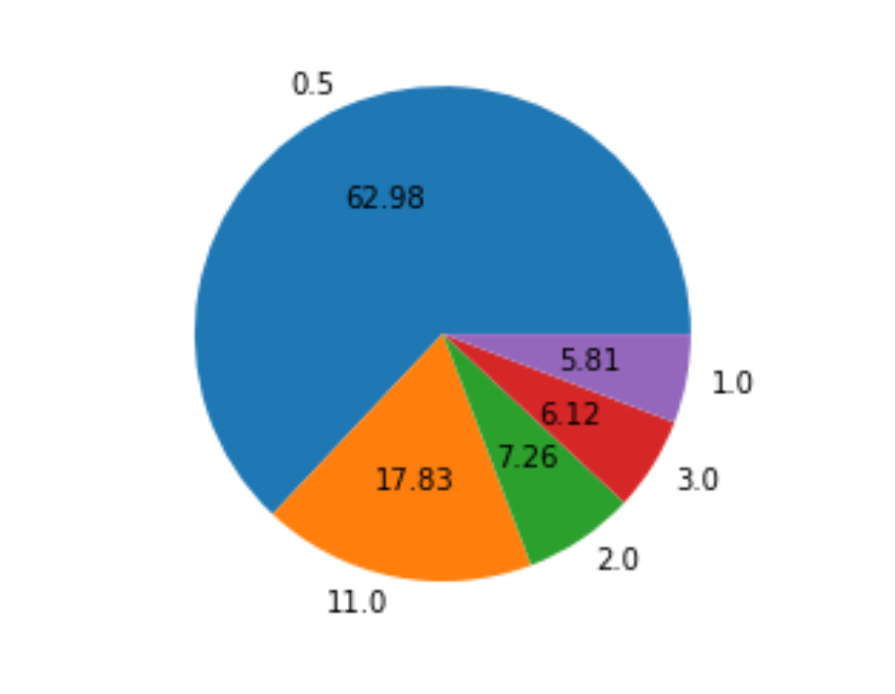
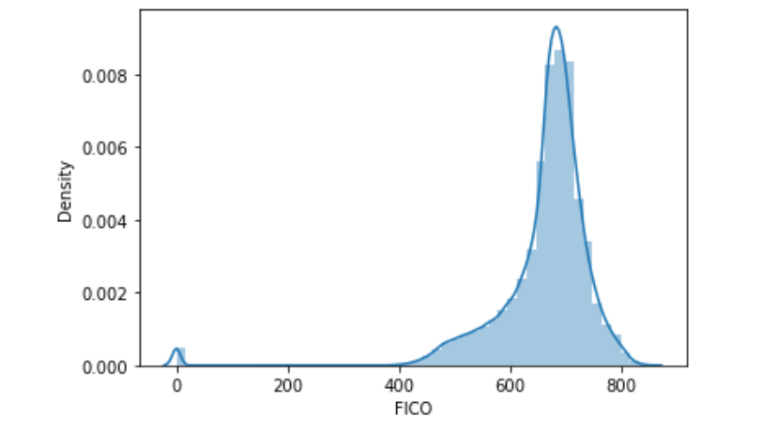
Observations:
In the Dataset most are the people have employment experience less than 1 year and then 11 years experience people are high
and then 2 years experience people are there
Observations:
The Data is right skewed since most of the data is present in right side
Most of the FICO score is between 600 to 700
We have some people with Zero FICO score also

Slide 9
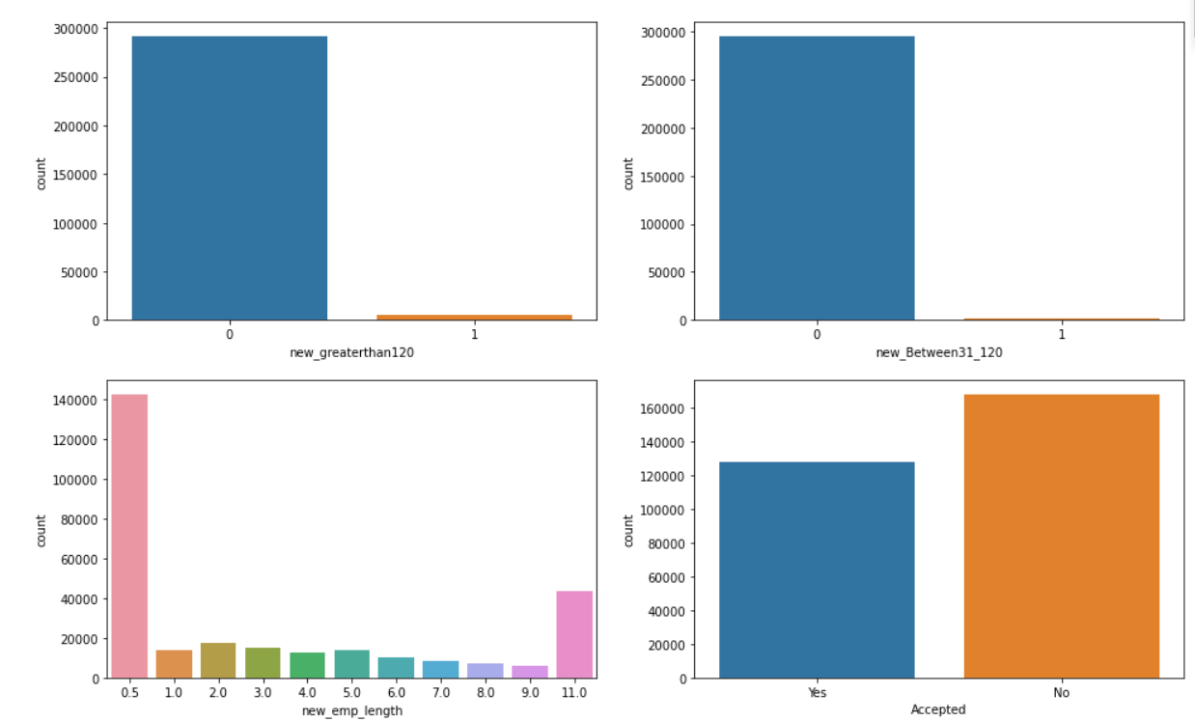
Univariate Analysis
Observations:
In the whole dataset we have more customers whose approval is not accepted
People with experience with <1 year are high and next people with experience 11 Years
People who havent taken 120 days to pay are very high
people who paid between 31 to 120 days are very less

Slide 10

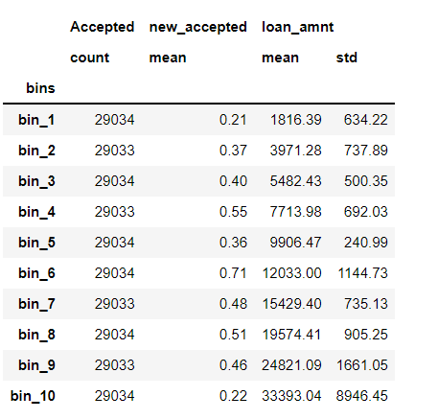
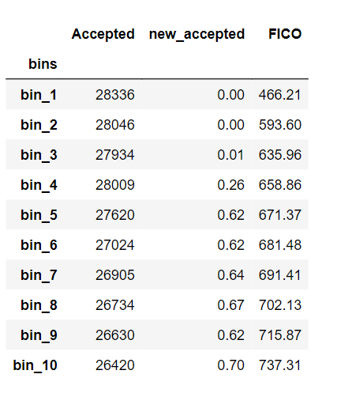
1. At an overall level, what % of loan applications were accepted?
43 percentage of applications are accepted at overall level
2. How does the % application approval change with the Loan amount?
Here since Loan amount score is numeric data so we created bins with some thresholds.
The Average loan amount are Indicated in loan_amnt column which is there in Increasing order.
The acceptance rate is high in the bin_6 where average loan amount is 12033 .
3. How does the % application approval change with the FICO score?
Here since FICO score is numeric data so we created bins with some thresholds.
The Average FICO scores are Indicated in FICO column which is there in Increasing order.
The more the average FICO score the More The acceptance rate .
So we conclude A low FICO score is indicative of high credit risk, and a high FICO score is indicative of low credit risk.
The Percentage of approval rate when the bin average is 737.31 is 70 percentage.

Slide 11
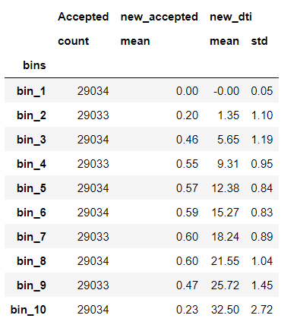
4. How does the % application approval change with the Loan amount?
Here since dti score is numeric data so we created bins with some thresholds.
The Average dti are Indicated in new_dti column which is there in Increasing order.
The acceptance rate is increasing till bin_8 that means till the average dti is 22 and then it is decresing slowly

Slide 12
Analysis by FICO score
Here since FICO score is numeric data so we created bins with some thresholds.
The Average FICO scores are Indicated in FICO column which is there in Increasing order.
The more the average FICO score the More The acceptance rate
So we conclude A low FICO score is indicative of high credit risk, and a high FICO score is indicative of low credit risk.
Analysis by DTI ratio:
Here since dti score is numeric data so we created bins with some thresholds.
The Average dti are Indicated in new_dti column which is there in Increasing order.
The acceptance rate is increasing till bin_8 that means till the average dti is 22 and then it is decresing slowly

Slide 13
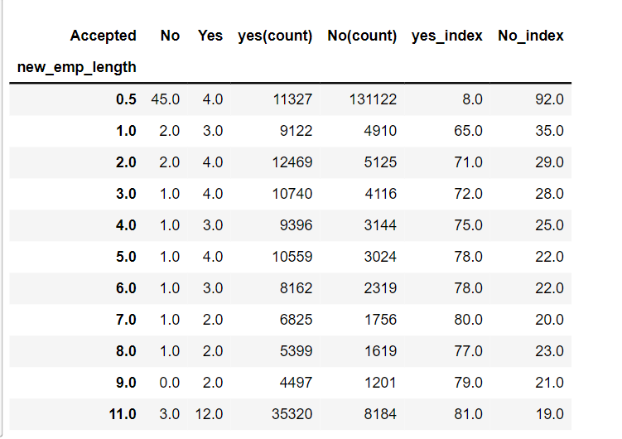
Analysis by employment:
Considering the data we have 12% of people whose loan is approved who has employment experience 10+ years.
For people whose employment length is more has more acceptance rate.
There is only 8% acceptance rate for people whose employement length is <1 year
So we consider A long employment tenure is an indicator of steady job and financial stability. It gives reassurance on customer paying back the loan amount.
1.Final Recommendations:
A Good FICO score Has a high chances of acceptance.
Employment length also results in acceptance rate higher the length higher the chances.
Dti score is also directly proportional to the acceptance rate.

Slide 14
Thank You
(Group 6)

